Slide 1
Occupational Specialist Component Content: Digital Production, Design and Development
The T Level T Level Technical Qualification in Digital: Digital Production, Design and Development includes a single Occupational Specialist Component. Therefore, there is a single synoptic assessment for the Occupational Specialist Component, which is an extended ‘design, development and implementation’ project. The synoptic element of the project is important in order to ensure that students are able to demonstrate threshold competence: this is the principal reason why the Occupational Specialism is assessed via a single extended project assessment to ensure that students are able to evidence all the skills required by the Performance Outcomes.
The T Level Technical Qualification in Digital: Digital Production, Design and Development Occupational Specialist Component consists of several activities grouped into four substantive tasks.
Each task will be completed during a window set by Pearson during which you will schedule supervised assessment sessions. In some cases, tasks will also involve opportunities for unsupervised activities where the requirements of the skills being assessed make this necessary.

Slide 2
Learning Objectives
Aims:
To understand planning and requirement analysis
Objectives:
To be able to plan and conduct a requirement analysis with specific references to:
Identify business requirements such as new software and amending/increasing security.
Assess the measurable value of the proposed solution in relation to the user and the client/business.
Apply computational thinking (decomposition, pattern recognition and abstraction) to split the problem into discrete objects.
Define the functional and non-functional requirements of the solution.
Define the key performance indicators (KPls) of the solution.
Identify the performance constraints in digital projects.
Create user acceptance criteria.
Schedule projects (tasks, subtasks, milestones).
Allocate appropriate resources to digital projects

Slide 3
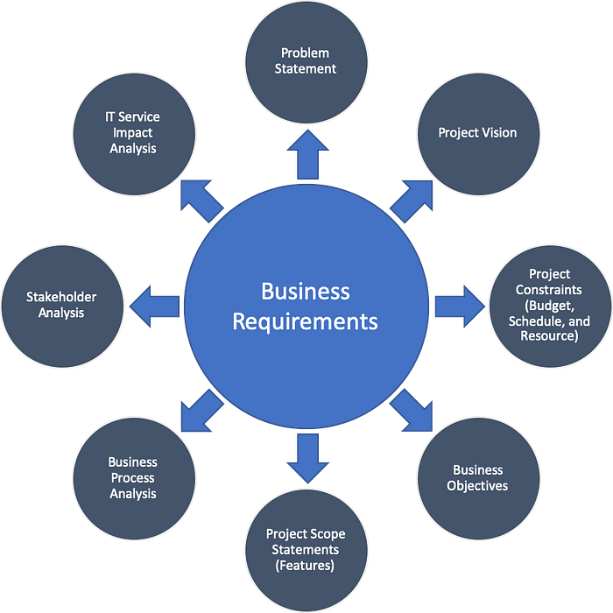
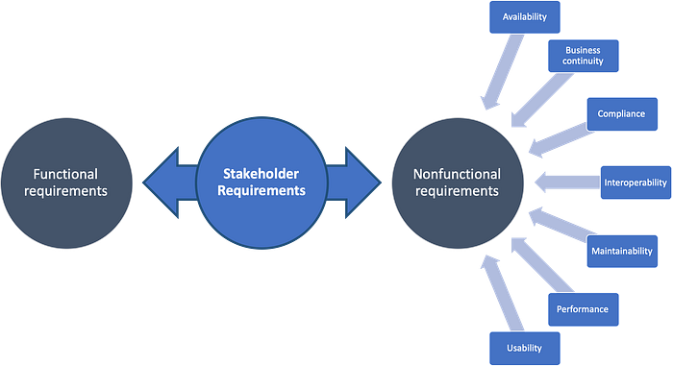
Identifying Business Requirements
Business requirements define what the organisation needs from a digital solution.
Intent: To uncover what must be built, changed, or secured.
Understand the client’s goals and pain points
Identify needs like new software features or improved security
Align requirements with business strategy and operations
Differentiate between essential and nice-to-have needs
Notes:
https://medium.com/@panicpotatoe/business-requirements-vs-stakeholder-requirements-8a5127c4fb12

Slide 4

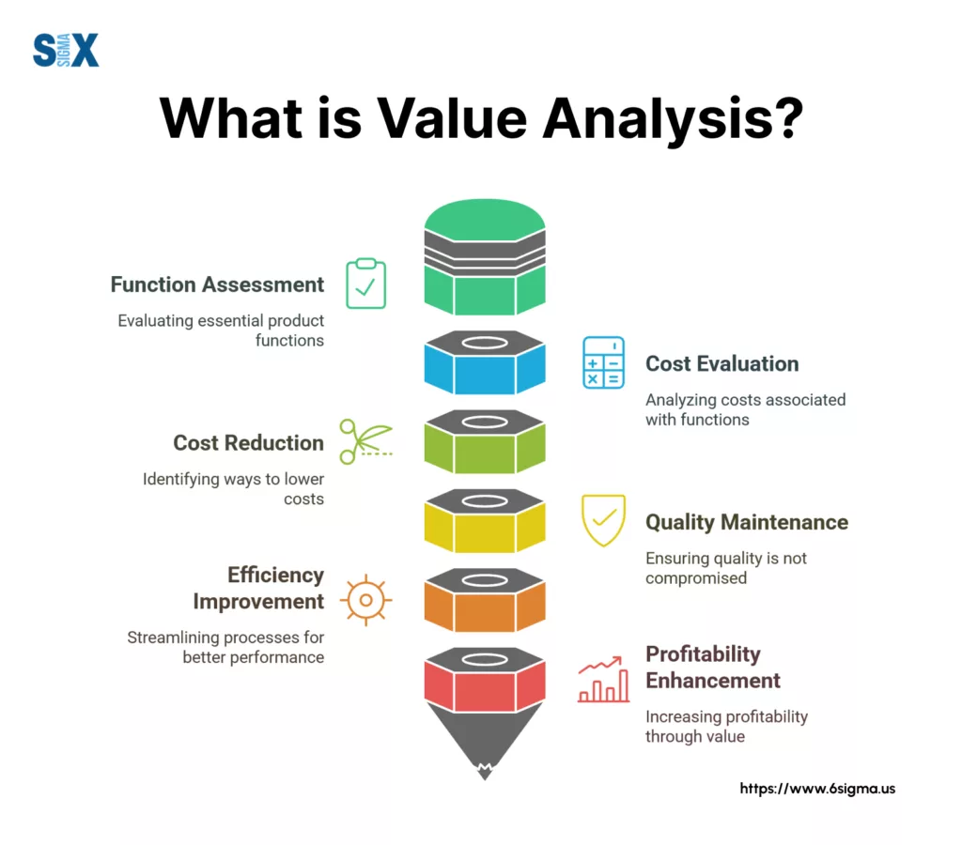
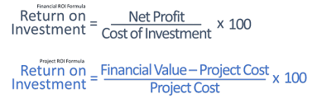
Assessing Measurable Value
Value must be clear for both the end-user and the business.
Intent: To ensure the proposed solution justifies its cost and effort.
Time saved, productivity improved, or costs reduced
Enhanced user experience or accessibility
Alignment with client KPIs (e.g., revenue, retention)
ROI: Does the benefit outweigh the investment?
Notes:
https://www.workpack.in/2018/01/23/return-investment-roi-engineering-construction-project-management-software/

Slide 5
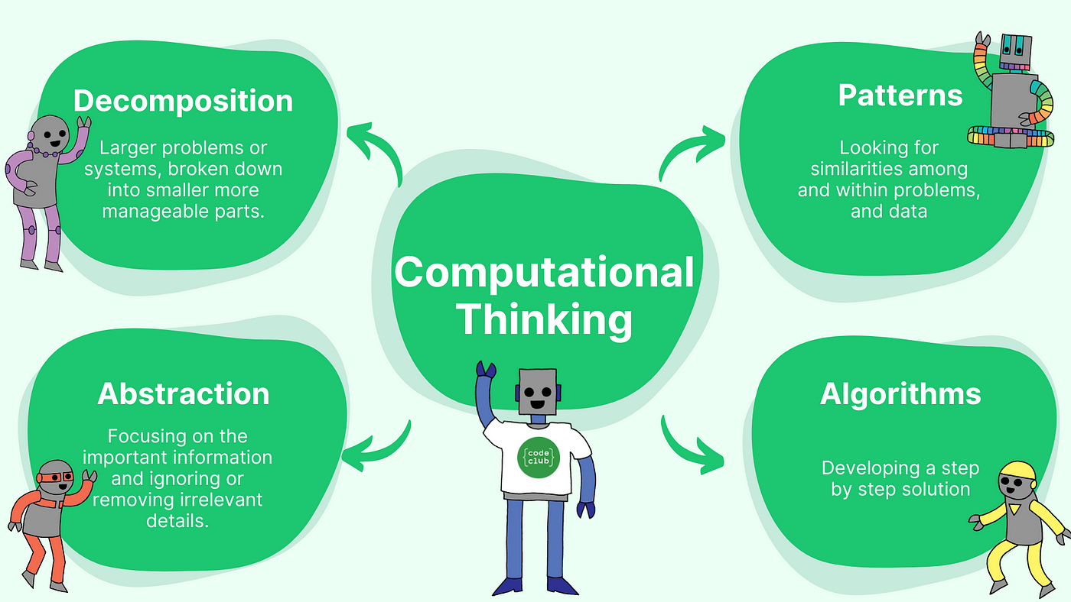
Applying Computational Thinking
Breaking complex problems into manageable parts helps define a structured solution.
Intent: To simplify design through logical decomposition.
Decomposition: Break down the problem into smaller components
Pattern recognition: Identify common elements and reuse logic
Abstraction: Focus on essential features only
Algorithmic Thinking: a step-by-step set of instructions or rules (an algorithm) to solve a problem.

Slide 6
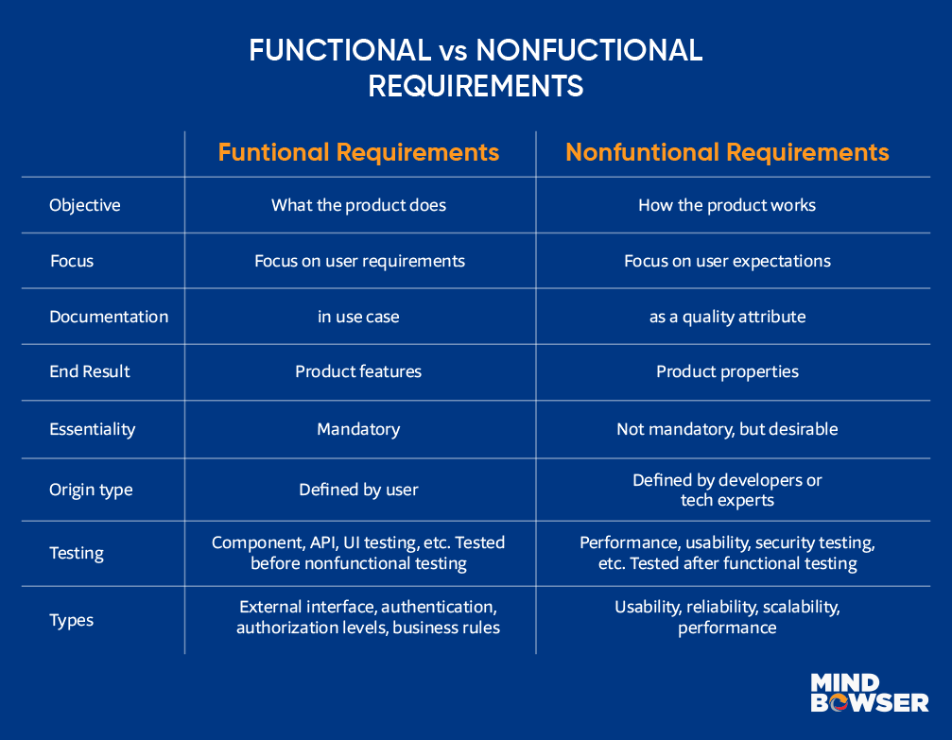
Functional & Non-Functional Requirements
Requirements must describe both what a system does and how it performs.
Intent: To produce a complete and testable specification.
Functional: Tasks, actions, features (e.g., login, data entry)
Non-functional: Performance, security, usability, scalability
Document scenarios, conditions, and business rules

Slide 7
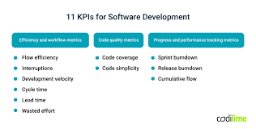
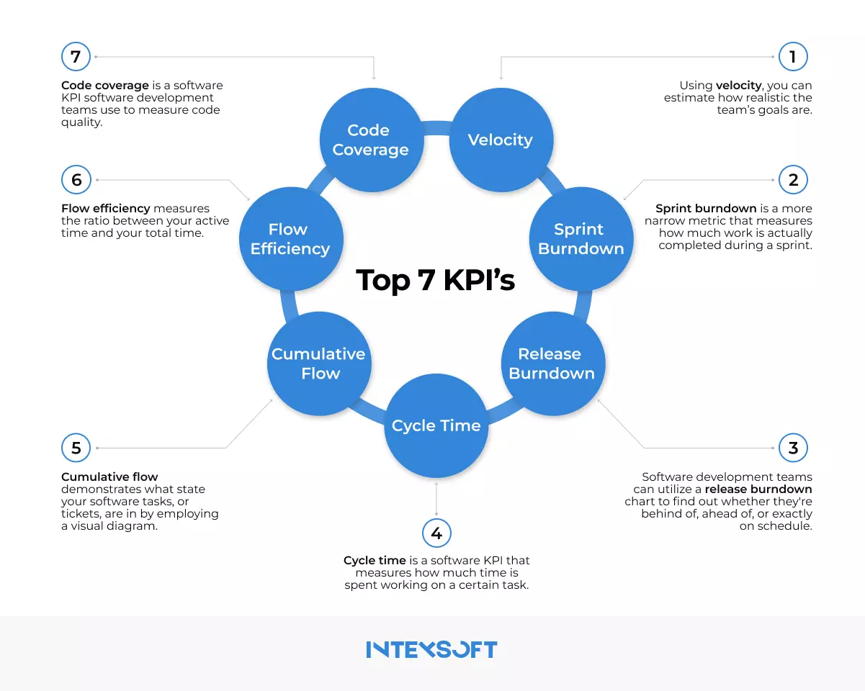
Key Performance Indicators (KPIs)
KPIs measure the solution’s effectiveness and success.
Intent: To define metrics for performance monitoring.
Uptime percentage
Average response/load time
User satisfaction or Net Promoter Score (NPS)
Feature adoption rates
Security incident frequency

Slide 8
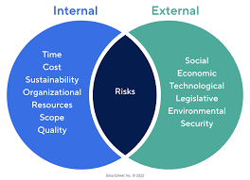
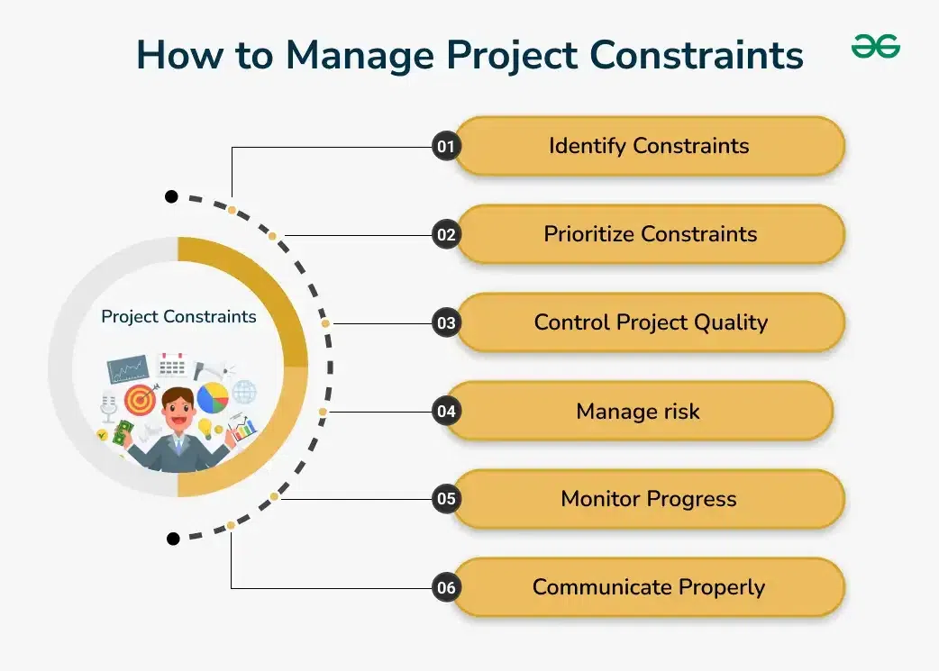
Identifying Performance Constraints
Constraints are limits that the system must operate within.
Intent: To plan around technical, financial, or user restrictions.
Server capacity or bandwidth
User load limits (e.g., concurrent users)
Software and hardware compatibility
Legal or budget limitations

Slide 9
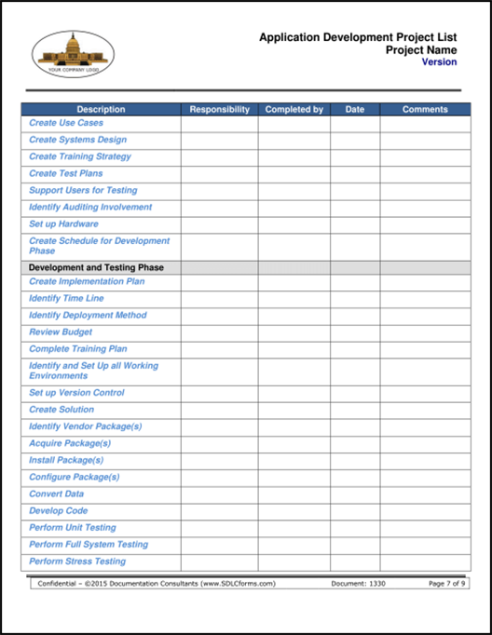
User Acceptance Criteria
Acceptance criteria define what must be true for users to approve the solution.
Intent: To set measurable standards for final delivery.
Clear, testable conditions
Based on user expectations and behaviours
Used during QA, testing, and sign-off
Written in a “Given/When/Then” format (e.g., BDD)

Slide 10
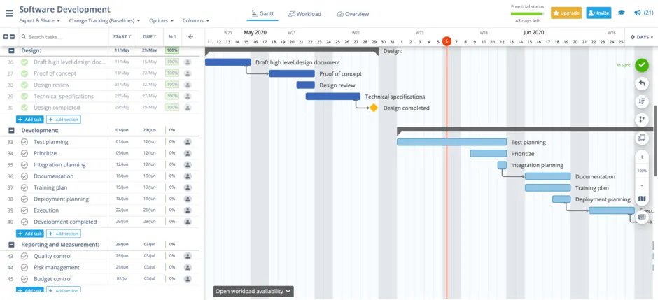
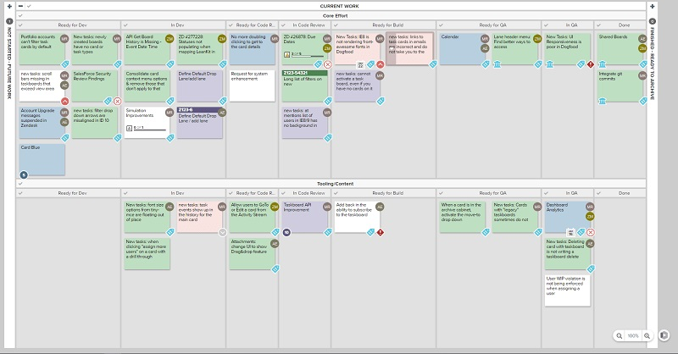
Project Scheduling
Scheduling organizes tasks, subtasks, and milestones to manage time and progress.
Intent: To define the timeline and keep the project on track.
Break down tasks and dependencies
Set realistic deadlines
Define major milestones (e.g., MVP, Beta, Launch)
Use tools like Gantt charts or Kanban boards
Notes:
Calendar with task cards or Gantt chart visual

Slide 11
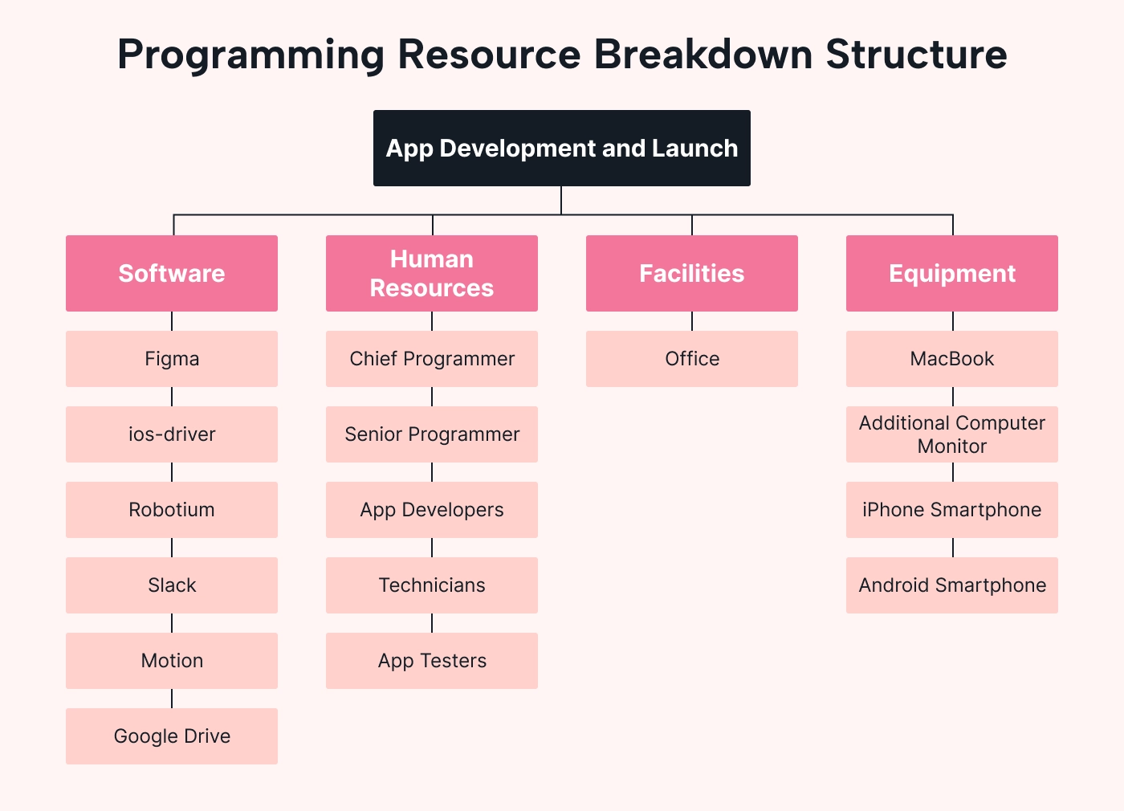
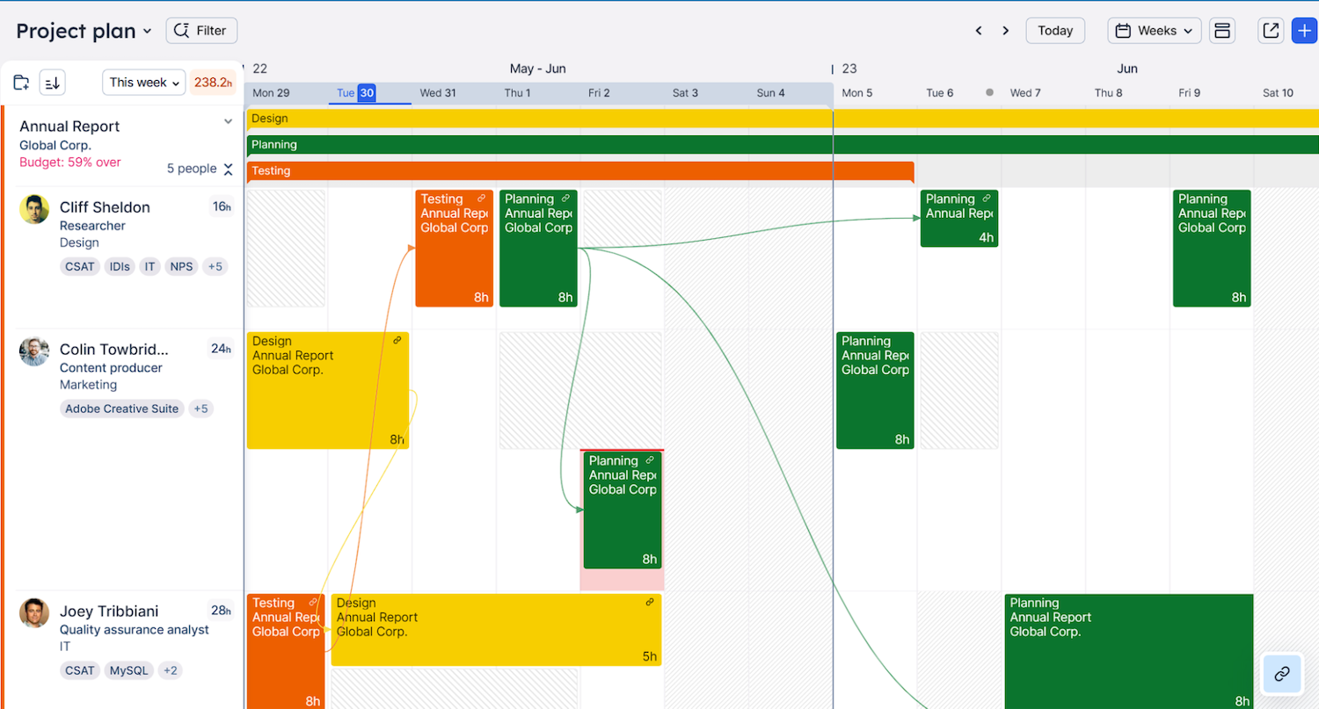
Resource Allocation
Assigning the right people and tools is essential for project success.
Intent: To optimise time, skills, and assets.
Identify required roles (developers, testers, designers)
Match tasks to skillsets and availability
Assign hardware/software resources
Balance workloads to avoid bottlenecks

Slide 12
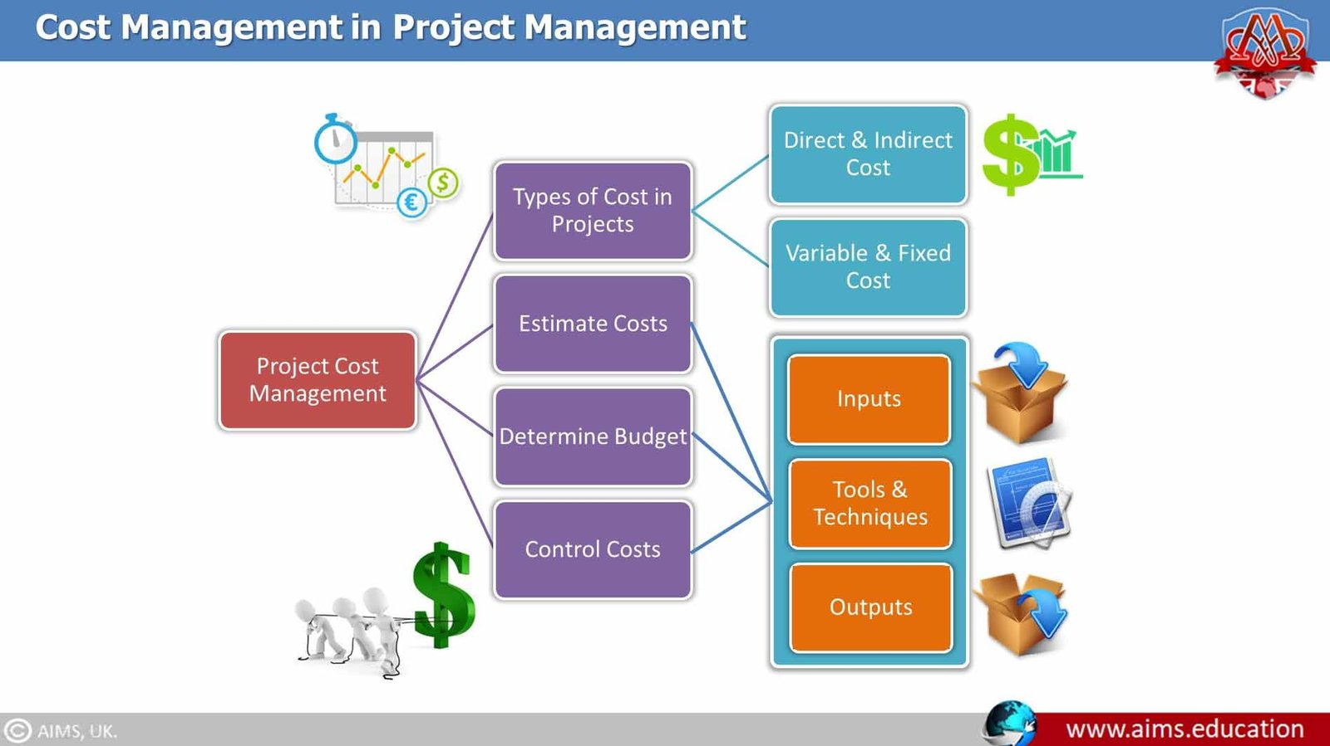
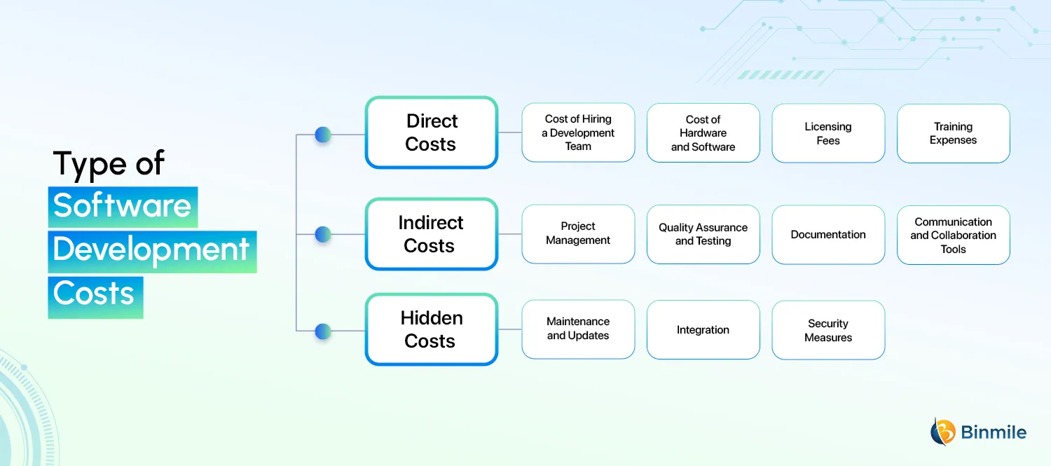
Estimating Costs in Digital Projects
Accurate cost estimation is crucial to avoid overruns and secure funding.
Intent: To understand and plan for the full financial scope of the project.
Identify direct costs: software, hardware, licensing
Estimate staff costs (developer hours, PM, QA)
Include hidden costs (e.g., support, training, maintenance)
Consider contingency for unexpected expenses (typically 10–20%)
Use cost estimation methods: top-down, bottom-up, analogous

Slide 13

Choosing Programming Languages
Selecting the right language ensures long-term success and system compatibility.
Intent: To evaluate languages against key project and business needs.
Suitability for task – e.g., Python for data, JavaScript for web
Organisational policy – use of preferred stacks or legacy systems
Scalability – can it support growth and added features?
Security – language vulnerabilities and community support
Availability of trained staff – ease of hiring or training
Costs – license fees, development speed
Reliability – proven track record and bug resistance

Slide 14
Language Comparison Example
Real examples can guide decision-making in choosing the best language.
Intent: To visually demonstrate how languages compare on key criteria.
Language | Task Fit | Scalability | Security | Staff Availability | Cost | Reliability
Python | High | Medium | High | High | Low | High
Java | High | High | High | Medium | Medium | High
PHP | Medium | Low | Medium | High | Low | Medium

Slide 15
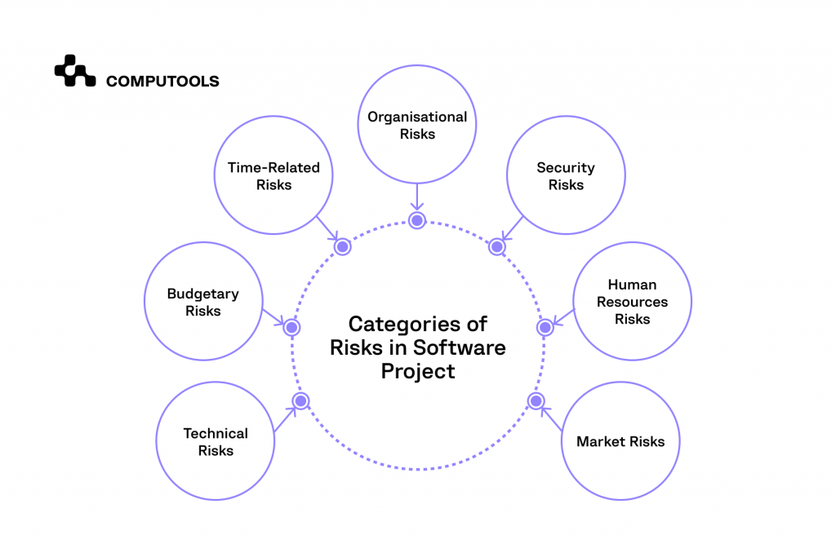
Identifying Risks in Digital Projects
Every digital project comes with technical, human, and business risks.
Intent: To anticipate issues before they impact the project.
Scope creep from unclear or changing requirements
Technical risks (bugs, integration failure)
Human risks (staff turnover, communication breakdowns)
Legal/data privacy compliance
Budget or time overruns

Slide 16
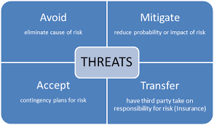
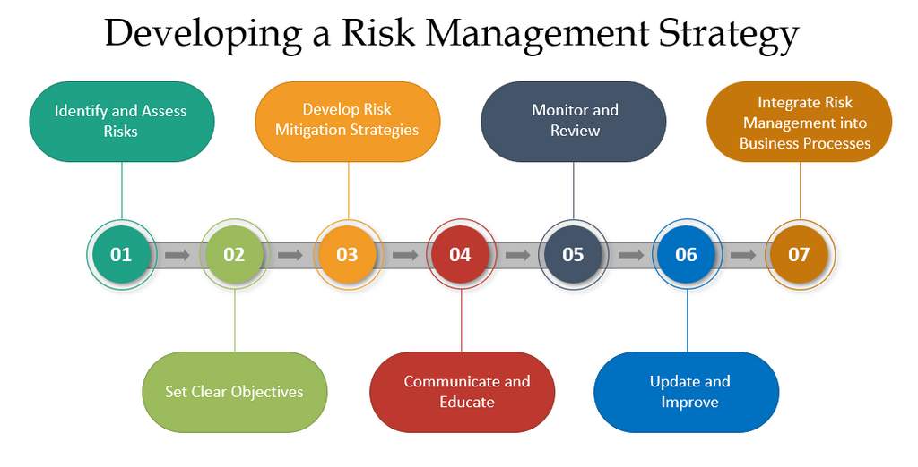
Risk Mitigation Strategies
Proactive risk management helps keep projects stable and on course.
Intent: To implement safeguards that reduce the chance and impact of risks.
Define clear requirements and scope early
Use version control and regular backups
Create buffer time in schedules
Assign risk ownership (who monitors what)
Regular reviews and agile sprints to catch issues early
Implement security best practices from day one

Slide 17

Activity - “Plan It Right”
A hands-on team activity to practise Planning and Requirement Analysis in a real-world project scenario.
Intent: To reinforce knowledge of requirement gathering, risk planning, and scheduling through role-based teamwork.
What You’ll Do:
Form a team of 3 and take on defined roles
Analyse a project brief for a non-profit web app
Identify functional/non-functional requirements
Choose programming tools and assess risks
Plan costs, tasks, milestones, and user criteria
Present a short project pitch
Notes:
Time: 45–60 mins Deliverable: 5-minute team presentation
Instructions:
Review the brief as a team (5–10 mins)
Each role completes their assigned tasks independently or in pairs (20 mins)
Collaborate to combine findings into a 5-minute mini-presentation (15 mins)
Present to the class or another team and get feedback (10–15 mins)
What They’ll Learn:
How to identify and define project requirements
How to use analytical and computational thinking
How to align technical choices with business needs
How to structure a plan using scheduling and budgeting
How to think collaboratively like a real-world team
Suggested visual aids
Blank Gantt chart or Trello-style task board template
Risk matrix or checklist
Requirement template with functional/non-functional columns
Programming language comparison chart

